Slide 1
CT EEB X1931-4
Advanced Lighting Controls PSD Study
Kathleen Sturtevant, ERS
March 29th, 2021

Slide 2


Agenda
2
Background
Preliminary Literature Review
Next Steps

Slide 3
Phase 1 Study Background
Phase 1 identified Advanced Lighting Controls as a new measure that should be added to the 2021 CT PSD
New Budget $50k to complete study and write up measure for PSD

Slide 4
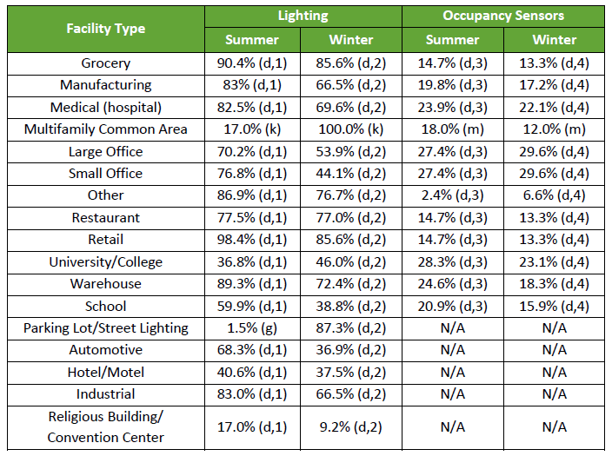
2021 CT PSD – Lighting Controls
C&I Lost Opportunity and Retrofit Lighting
  Savings methodology offered for occupancy sensors (OS) as part of standard lighting measure
  Energy savings determined using 0.3 as the average hour reduction due to OS.
  Demand savings calculated with OS CFs
  Lost Opportunity: Savings determined for buildings over 5,000 ft², if they have occupancy sensors beyond code-required scheduled lighting controls (per IECC 2018)
  Retrofit: Notes that additional savings may be claimed if lighting fixtures have multiple controls (daylighting, personal tuning, or institutional tuning) and/or integrated controls
Residential
  Lighting measure does not include information on lighting controls
Lighting Peak Demand Coincidence Factors (CFs)

Slide 5
Other TRMs
MA TRM 2019-2021
  Advanced Lighting Design: Calculates savings by applying a minimum percent of controlled lighting above required amounts for each tier in the Performance Lighting Program and 80% savings to the proposed lighting LPD
    No reference for calculation
  Lighting Controls: Applies energy savings factor based on type of control (daylight dimming, occupancy sensor, dual sensor/other, exterior)
    DNV KEMA (2014) Retrofit Lighting Controls Measures Summary of Findings FINAL REPORT
Wisconsin TRM 2020
  Includes 8 separate measures for lighting controls, each applying a savings factor based on control type (Daylighting, Bi-Level Controls, Occupancy Sensors, Photocell, and Networked Lighting Controls)
    Daylight Dimming: Williams, Allison., B. Atkinson P.E., K. Garesi Ph.D, E. Page P.E., and F. Rubinstein, FIES. “Lighting Controls in Commercial Buildings.” Luekos Vol. 8, No. 3 (January 2012).
    Occupancy Sensors: PA Consulting Group. Focus on Energy Evaluation, Business Programs: Deemed Savings Manual V1.0. March 22, 2010. Table 3.2 and Table 4-163.
    Networked Lighting Controls: Lighting Research Center. “Literature Review of Energy Savings from Luminaire-Integrated Controls.” Last revised November 19,2015.

Slide 6
Other TRMs
NY TRM 2020
  Calculates savings using an Energy Savings Factor based on type of control, building type, and operating hours
    DesignLights Consortium – Networked Lighting Controls V3.0 Requirements and Energy Savings from Networked Lighting Control (NLC) Systems, September 21, 2017
Mid-Atlantic TRM 2020
  Includes separate measures for Advanced Lighting Design, Occupancy Sensors, & Daylight Dimming
    Occupancy Sensors: EmPOWER Maryland DRAFT Final Impact Evaluation Report Evaluation Year 4 (June 1, 2012 – May 31, 2013) Commercial & Industrial Prescriptive & Small Business Programs, Navigant, March 31, 2014
    Daylight Dimming: Williams, A., B. Atkinson, K. Garesi, E. Page, and F. Rubinstein. 2012. “Lighting Controls in Commercial Buildings.” The Journal of the Illuminating Engineering Society of North America (3): 161-180.
  Networked Lighting Controls: Calculates savings using Energy Savings Factor for networked lighting controls on a site-specific basis or by building type
    DesignLights Consortium – Networked Lighting Controls V3.0 Requirements and Energy Savings from Networked Lighting Control (NLC) Systems, September 21, 2017; modified to reflect Mid-Atlantic metering study lighting baseline hours of us, which was supported by NLC – LRC Literature Review November 19, 2015.

Slide 7
Other TRMs
Illinois TRM 2020
  Calculates savings using an Energy Savings Factor based on type of control
    Networked Lighting Controls: custom/site-specific, no reference
    Vacancy Sensors: Papamichael, Konstantions, Bi-Level Switching in Office Spaces, California Lighting Technology Center, February 1,2010. See Figure 8 on page 10 for relevant study results.
    Luminaire Level Lighting Controls and 10% High End Trim:
      Pacific Northwest National Laboratory, “Evaluation of Advanced Lighting Control Systems in a Working Office Environment”, November 2018.
      Schuetter et al., “Cree SmartCast Lighting Retrofit Demonstration: LED Fixtures and Controls for Advanced Holistic Lighting Solutions”, September 2020 (expected).
      DesignLights Consortium and NEEA, “Energy Savings from Networked Lighting Control and Luminaire-level Lighting Control Systems: 2020 Update”, 2020 (expected).
    Refrigerated Case Occupancy Sensors: SDG&E workpaper: WPSDGENRLG0027
    Exterior Sensors: "Application Assessment of Bi-Level LED Parking Lot Lighting" p6.
    All others: Williams et al, "Lighting Controls in Commercial Buildings", 2012, p172.

Slide 8
Next Steps
Any available data, studies, or other secondary research that the EA has knowledge of and would want us to review?
Possibly conduct exploratory, informal interviews before focusing the approach and methodology to achieve objective.

Slide 9
Thank You
9

Slide 10

Kathleen Sturtevant, Senior Engineer
ksturtevant@ers-inc.com
978-332-5831
ERS is an energy and engineering consulting firm providing services in energy efficiency customer engagement, implementation, evaluation, both pre- and post-installation M&V, custom feasibility studies, and distributed and renewable generation assessment.

