Slide 1
ES Budget Update
December 13, 2023

Slide 2
Eversource Updates Since Tech Session
Statewide revenues, spending and year-end (Y/E) forecast
ES spending and Y/E forecasts using October YTD numbers
ES year-end forecast comparison to prior month

Slide 3
All Company Revenues, Spending and Year-End Forecast

Slide 4
Eversource Summary ($ Millions)
Previous forecast was $12.1M or 8.2%
Current forecast is $12.4M or 8.4%

Slide 5
Eversource Forecast (Oct vs. Sep) in $Millions

Slide 6
Appendix Slides

Slide 7
2023 Budget Mitigation Summary (C&I)
Measure / Change | Estimated $ Impact (Range) Over 12 Months | Vendor / Contractor Impact (Utility perspective) | Implementation Timeline | Avangrid Perspective / Impacts | Permanent / Temporary
Pause new paid advertising marketing activity | N/A | Fewer leads. No new paid advertising generated leads for 2023 project implementation | Remainder of 2023 | Eversource only action | Temporary. Marketing for programs such as small business will resume for 2024
Reduce standard LED midstream lighting incentives | $500K in 2023 | Fewer midstream standard LED projects | 9/1/2023 | Eversource only action | Permanent. Midstream reduction was being contemplated for 2024 and this reduction will remain in place
Eliminate $250/ton midstream heat pump incentives and only rely on downstream incentive | $200K in 2023 | May slightly reduce the number installs | 10/1/2023 | Keep $250/ton through 2023, drop for 2024 | Permanent. Midstream incentives were planned to be removed for the 2024 program year

Slide 8
2023 Budget Mitigation Summary (Residential)
Measure / Change | Estimated $ Impact (Range) Over 12 Months | Vendor / Contractor Impact (Utility perspective) | Implementation Timeline | Avangrid Perspective / Impacts | Permanent / Temporary
Eliminate $250/ton instant rebate on Residential heat pumps | $1.5M in 2023 | ~600 contractors in the Heat Pump Installer Network, may slightly reduce installs | 10/1/2023 | Keep $250 through 2023, drop for 2024 | Permanent. Midstream incentives were planned to be removed for Program Year 2024
Pause outreach marketing | N/A | Fewer leads and reduced program activity | Already in place | No planned Avangrid-led marketing reductions | Temporary. Direct outreach campaigns per CoA will resume in 2024. Other program marketing will be utilized based on program uptake
Single-family HES-IE incentive updates for window and heat pump measures | Windows: $5M - $7.5M annually Heat pumps: $1M annually | Windows: lower volume of upgrades Heat pumps: larger projects will need customer contribution | Already in place | In agreement with Eversource (windows and heat pumps), strategies already in place | Permanent
Change HES and HES-IE past participation look back to 6 years (Evaluation) | N/A | Minimal | Already in place | In agreement with Eversource | Permanent. Plus, proposed increase to 10 years as part of the 2024 Plan Update
Discontinue incentives for dehumidifiers and appliances recycling | $200K in 2024 | Minimal | Appliance Recycle: 9/2023 Dehumidifier: 1/1/2024 | In agreement with Eversource | Permanent

Slide 9
2024 Budget Mitigation Summary (Residential)
Measure / Change | $ Impact (Range) Over 12 Months | Vendor / Contractor Impact | Proposed Implementation Timeline | Avangrid Perspective / Impacts
Increase co-pay from $50 to $75 (Budget) | ~$300K (Eversource only) | Solar companies pay for the co-pay, little or no impact HES contractors may have a harder sell | 1/1/2024 | In agreement with Eversource
Reduce heat pump rebate from $1,000/ton to $500/ton | N/A, serve more customers with lower rebates and with a similar budget | ~600 contractors in the Heat Pump Installer Network | 1/1/2024 | In agreement with Eversource
Pause outreach marketing | N/A | Fewer leads and reduced program activity | Already in place, continuing into 2024 | No planned Avangrid led marketing reductions
Reduce demand response performance incentives for legacy battery storage installations | $250K | Customer impact vs. Vendor | 1/1/2024 | No Avangrid impacts
Change HES and HES-IE past participation look back to 10 years (Evaluation) | N/A | Minimal | TBD | In agreement with Eversource
Eversource to issue POs in HES and HES-IE commensurate with 2024 Budgets | Results in a reduction of $17M - $21M, compared to 2023 | POs will support activity in line with Program Year 2020, approximately | POs effective for Program Year 2024 | No Avangrid impacts
Move Advanced Duct Sealing to qualified HES rebate (Evaluation) | ~$600K - $800K | Will need to use a sales model utilizing 0% interest financing | 1/1/2024 | In agreement with Eversource

Slide 10
Regulatory Authority
See Department of Energy and Environmental Protection’s (“DEEP”) Final Decision, 2013-2015 Electric and Natural Gas Conservation & Load Management Plan, Oct. 31, 2013, p. 21, DEEP states: “Therefore, as a general policy, DEEP requires the Companies to detail any proposals to spend forward in the Annual Updates submitted to DEEP in the interim years of any three-year C&LM plan period. The EEB may monitor and approve any forward spending of 15 percent or less of the subsequent year’s budget. Any forward spending above the 15 percent threshold amount may not proceed without prior authorization by DEEP, which authorization could be requested at any time by the electric distribution companies (“EDCs”) and the local distribution companies (“LDCs”)

Slide 11
Eversource Request to EEB
- Allow Eversource to spend forward up to 10% of 2024 budget and mitigate situation over next 16 months
- Approving request will allow mitigation tactics and strategies to slow down spending in 2023 and be effective all year long in 2024, and avoid having to close program activity for 2-to-3 months

Slide 12
Additional 2024 HES and HES-IE Considerations
Insulation incentive / measure changes (evaluation and budget)
HES-Income Eligible, limit comprehensive incentive (budget)

Slide 13
Combined Summary ($ Millions) Summary

Slide 14
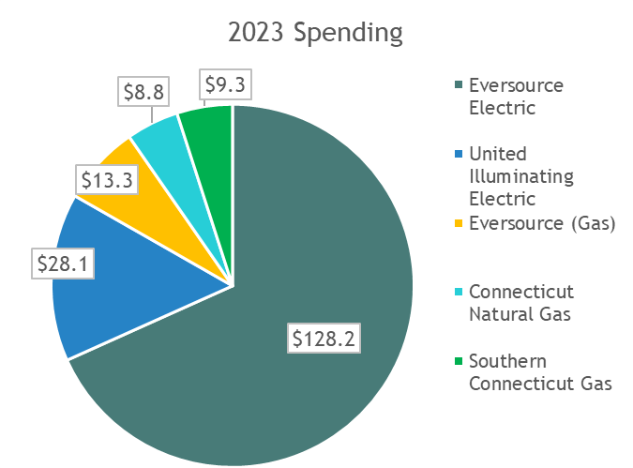
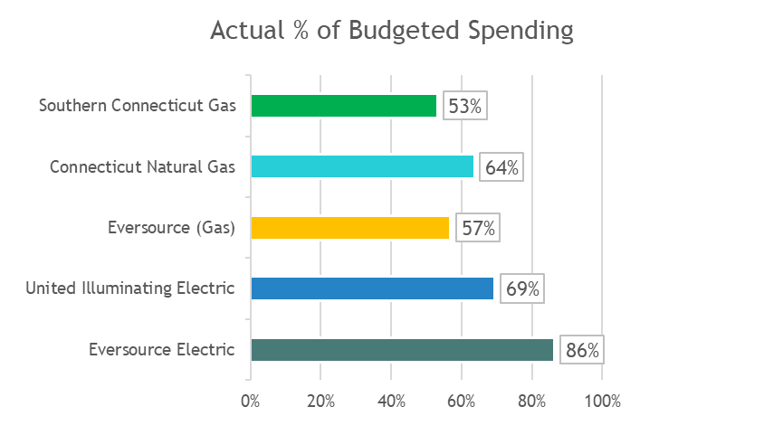
Spending Summary (in millions)

