Slide 1
Update: 2024 Plan Update
Presented to EEB: February 14, 2024
Updated and Presented to Tech Consultants and DEEP: February 20, 2024
Presented to CTAC: February 21, 2024
Presented for EEB Vote: February 29, 2024

Slide 2
Overview
HES / HES-IE Purchase Orders
2024 Revenues & Budgets
Appendix
2023 Revenues with Park City

Slide 3
2024 Statewide Summary of Changes
(from February 14 EEB Presentation)
Area | Changes
Park City Revenues | Modeled Alternative Scenario 2 – Eversource 22% C&I: UI 50% C&I
ARPA Funds | Modeled in 2024 without PMI to the Companies
Recommend this Scenario for EEB Approval | Provides $4M increase to Residential Portfolio from 11/01/2023 filing Provides $5.4M increase to the C&I Portfolio from the 11/01/2023 filing

Slide 4
EEB Follow-Up Information from
(Presentation February 14, 2024)
Item | Notes / Changes
Provide Savings model for the 78/22 scenario | Pro-rated MMBtu savings based on budget changes
Breakdown of Costs contributing to the $1.6M administrative spend | Reference Slide 42 in the Appendix
Plan for safeguards to put in place that will alert Board of overspend earlier in the year | Provide EEB with YTD spending and add forecasts for any program forecasted to be over budget
Quantify workforce impact and PO levels for each scenario | Companies provided vendor/ PO impacts on slides 10 to 12. There are 26 vendors with varying sizes and structures, and it would be difficult to pin down exact workforce quantities. Note: ES and Statewide HES and HES-IE budgets in the proposed scenario are increasing from the 11/1/23 filing. This scenario is being recommended
Data indicating the decrease in contract value of the vendor PO and the associated vendor size | Companies provided vendor / PO impacts on slides 10 to 12. Note: PO amounts associated with the level of spending that occurred in 2023 would require an additional $20M for HES/HES-IE
Rate used by Companies for carrying charge | Weighted Average Cost of Capital is 8.98% is used for carrying charges

Slide 5
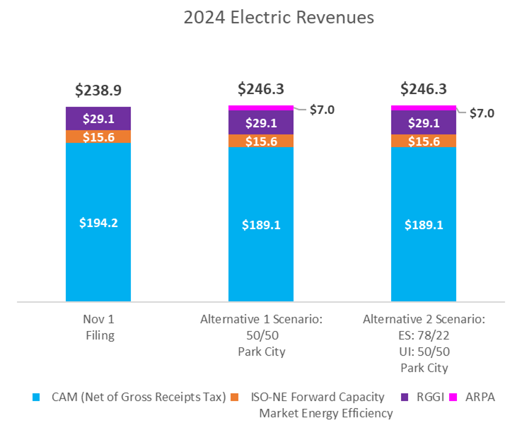
2024 Electric Revenues (vs. 11/1/2023)
*Park City funds were received in 2023

Slide 6
2024 Budgets
(all Companies)

Slide 7
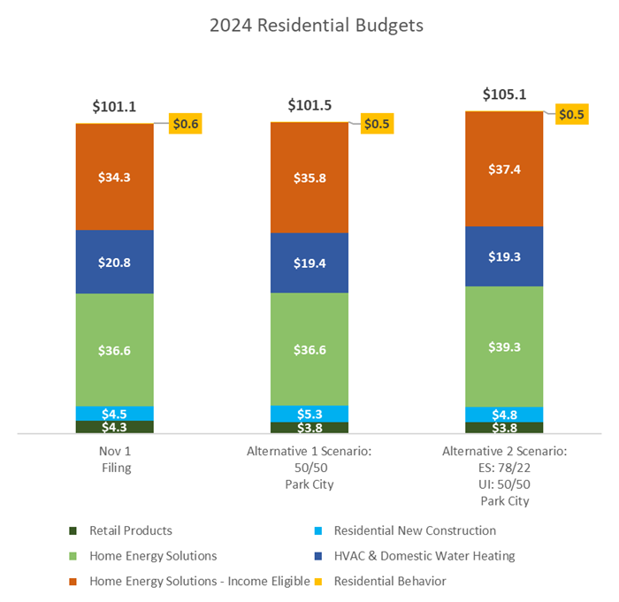
2024 Residential Budgets
(Scenarios vs. 11/1/2023)

Slide 8
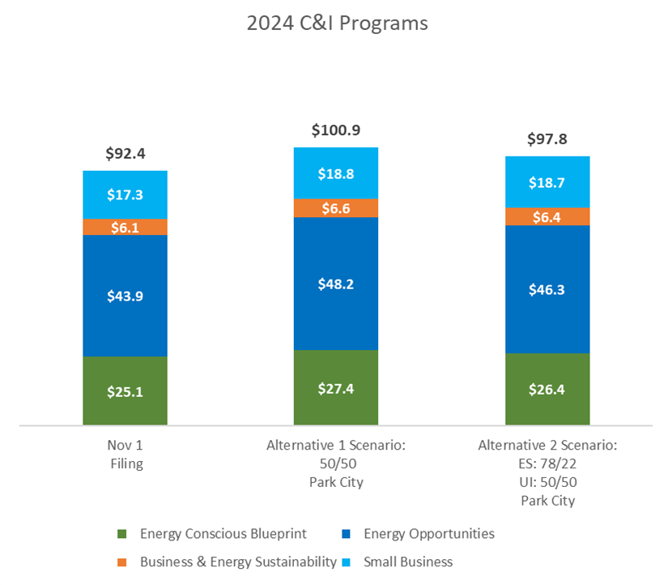
2024 C&I Budgets
(Scenarios vs. 11/1/2023)

Slide 9
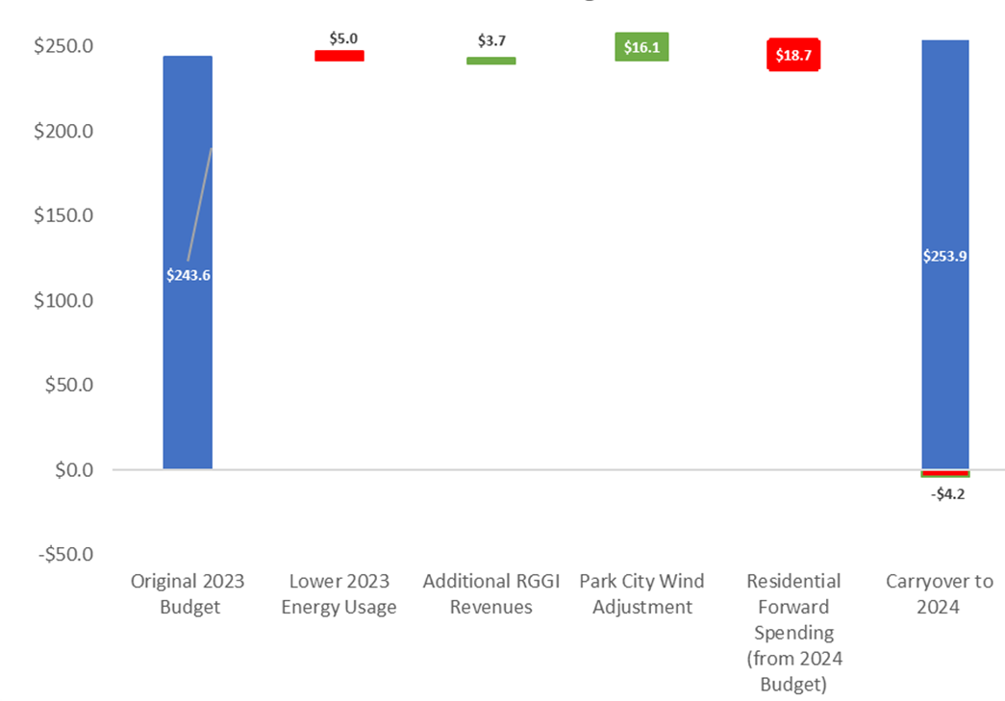
2023 Electric Revenues w/Park City
Park City Funds were received in 2023
Eversource used funds to offset Residential carryforward
UI funds will be used in 2024

Slide 10
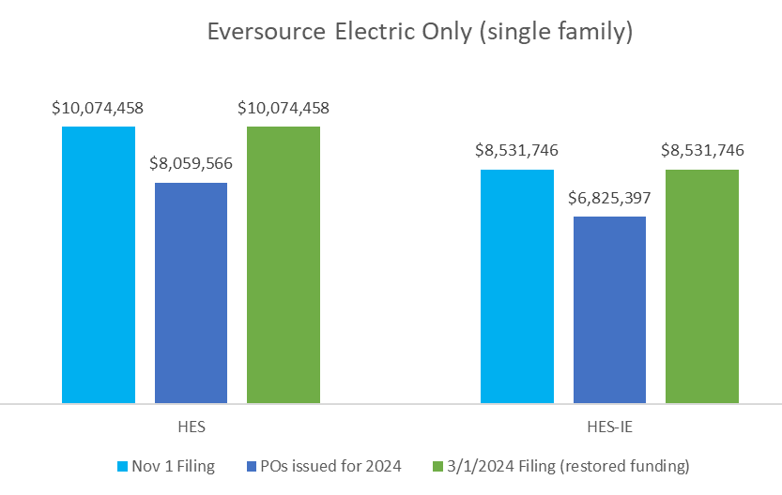
HES / HES-IE Purchase Order Changes (Eversource only)
POs were originally reduced due to EEB's guidance to reduce forward spending in Residential sector only. Eversource will work with the HES and HES-IE vendors that need additional PO allocations

Slide 11
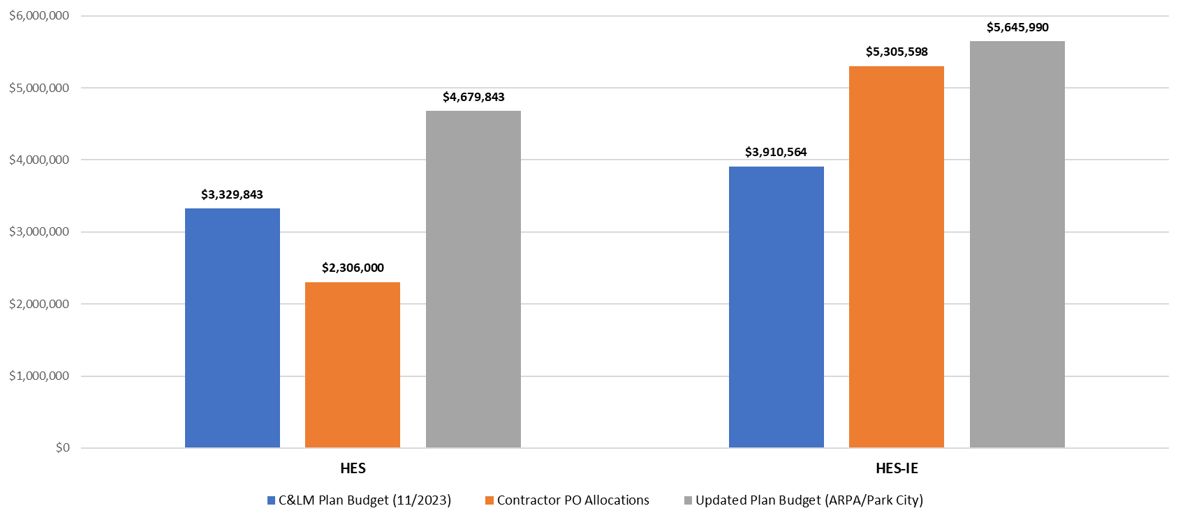
HES / HES-IE Purchase Order Changes (United Illuminating only)
Contractor productivity and budget management in 2023 thrived. With higher 2024 budgets, we expect similar or better results

Slide 12
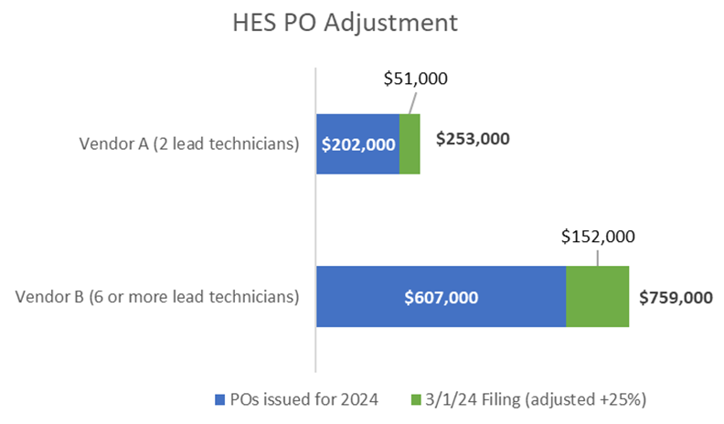
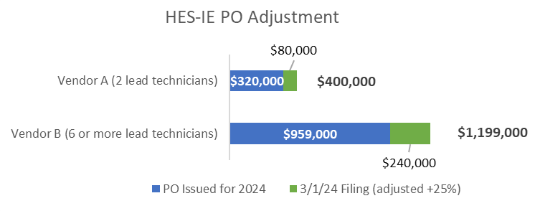
Impact on Small vs. Large HES Vendor POs (Eversource only)

Slide 13
2024 Statewide Summary of Changes (Budgets and MMBtu)
11/01/2023 Filing vs. 03/01/2024 Filing (ES: C&I 22%; UI: C&I 50%)

Slide 14
2024 Statewide Summary of Changes (Budgets continued)
11/01/2023 Filing vs. 03/01/2024 Filing (ES: C&I 22%; UI: C&I 50%)

Slide 15
2024 Residential and C&I Budgets

Slide 16
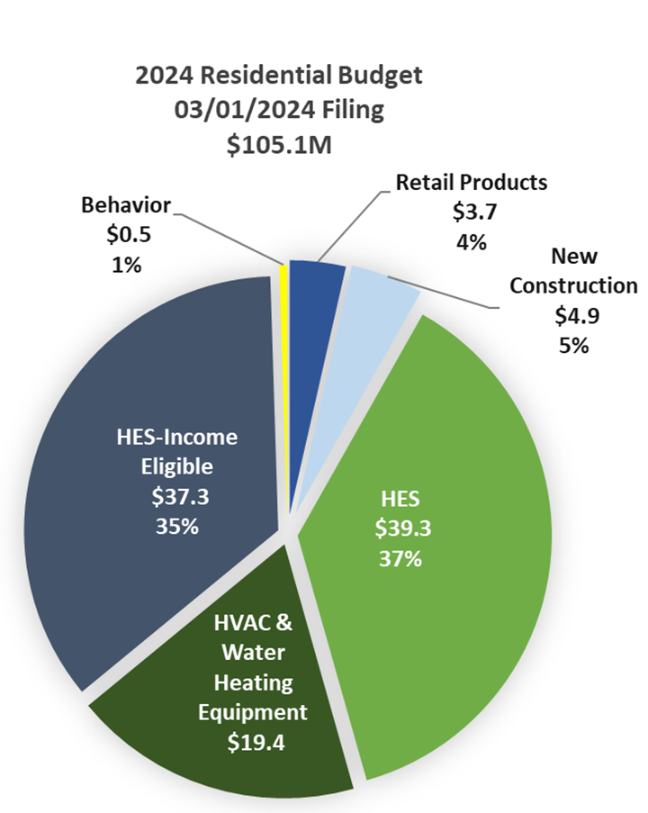
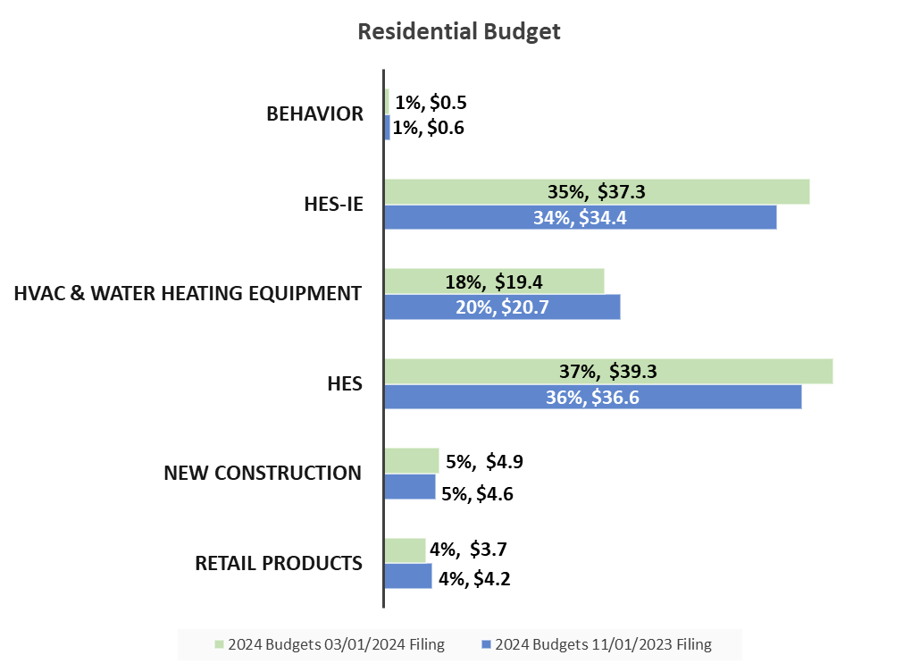
2024 Residential Budget
(compared to 11/1/2023 filing)

Slide 17
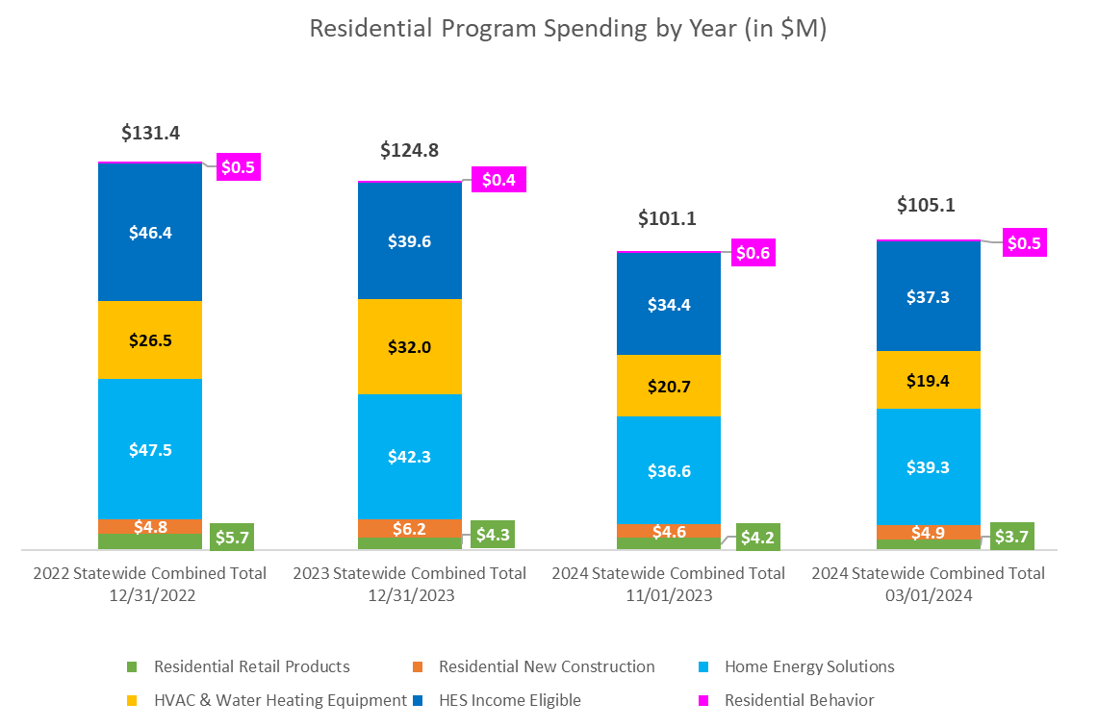
2022-2024 Residential Budgets

Slide 18
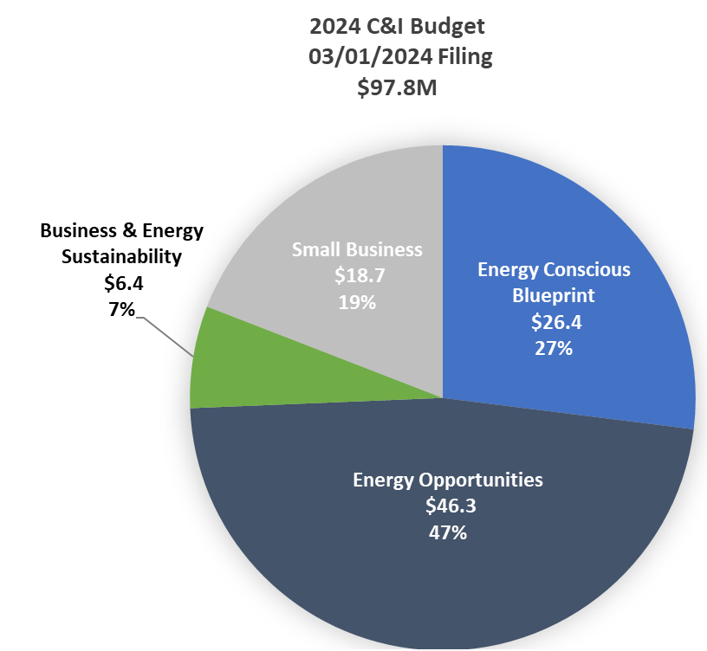
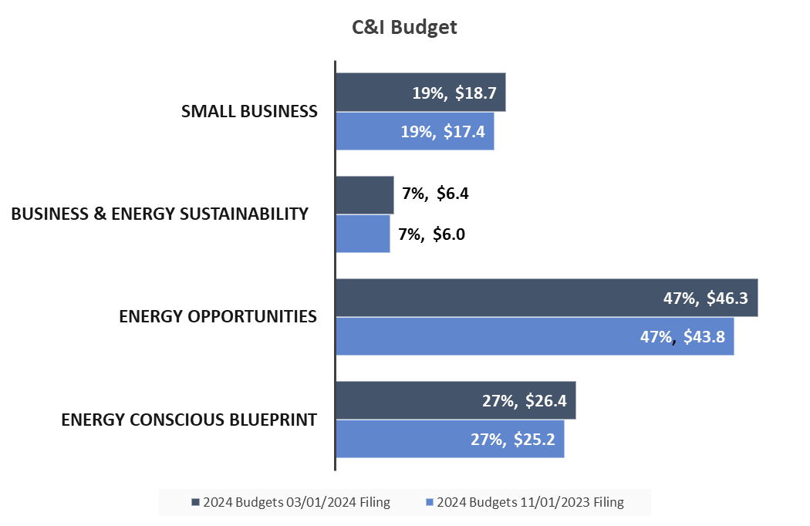
2024 C&I Budget
(compared to 11/1/2023 filing)

Slide 19
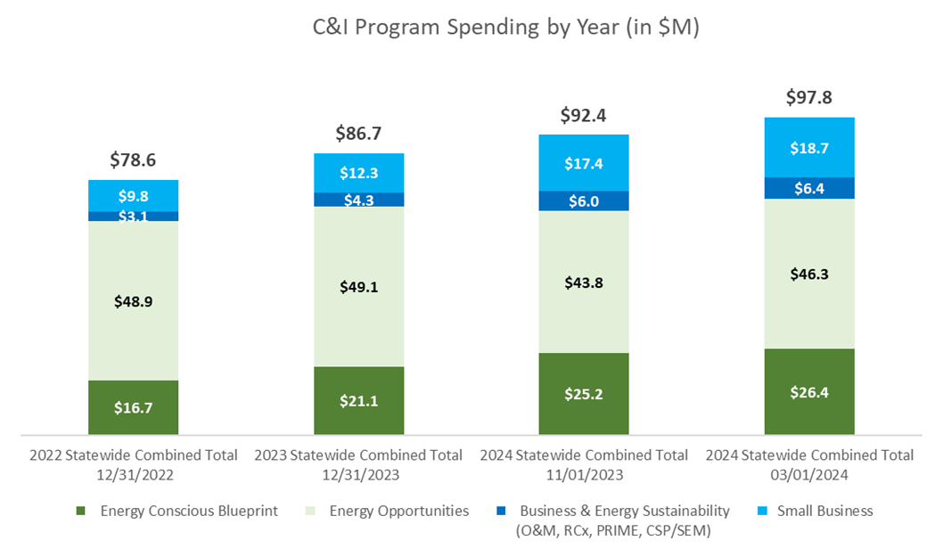
2022-2024 C&I Budgets

Slide 20
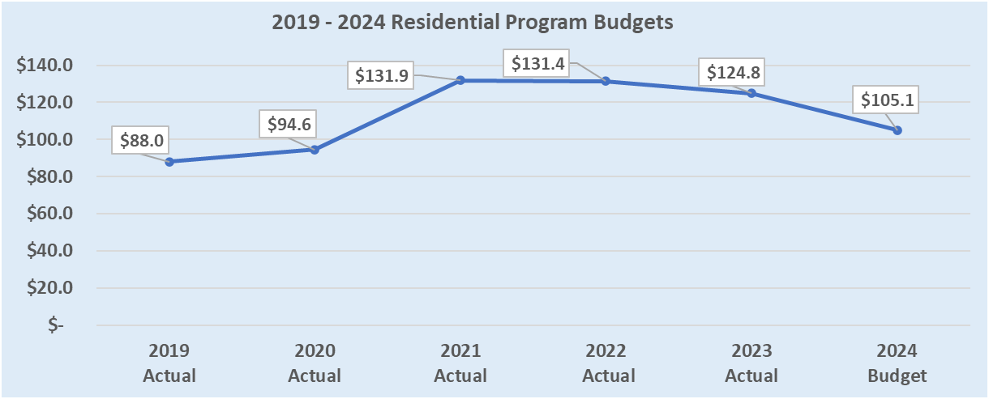
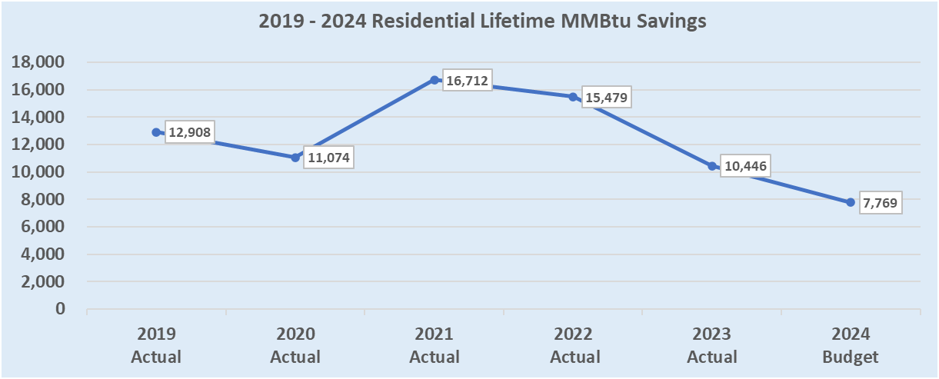
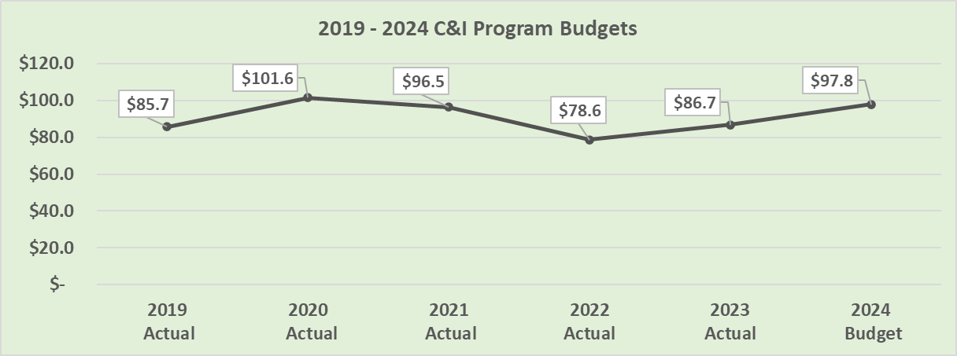
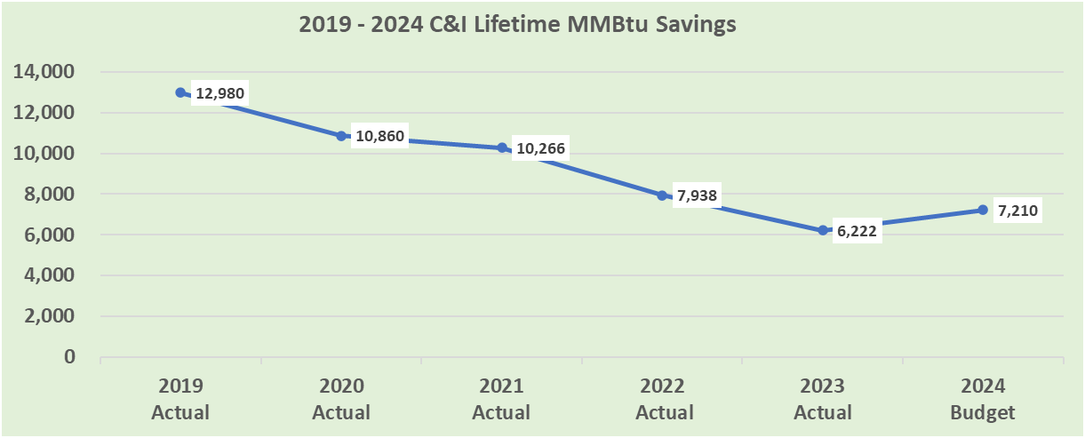
2019–2024 Residential and C&I
Spending and Savings

Slide 21
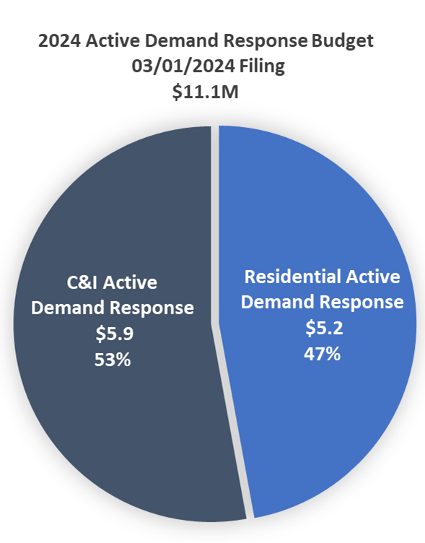
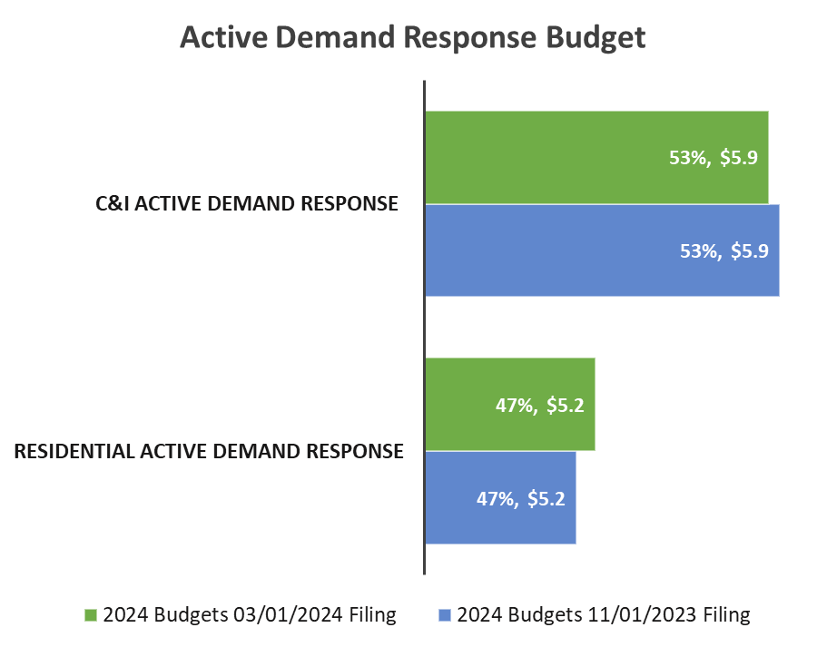
2024 Active Demand Response Budget
(compared to 11/1/2023 filing)

Slide 22
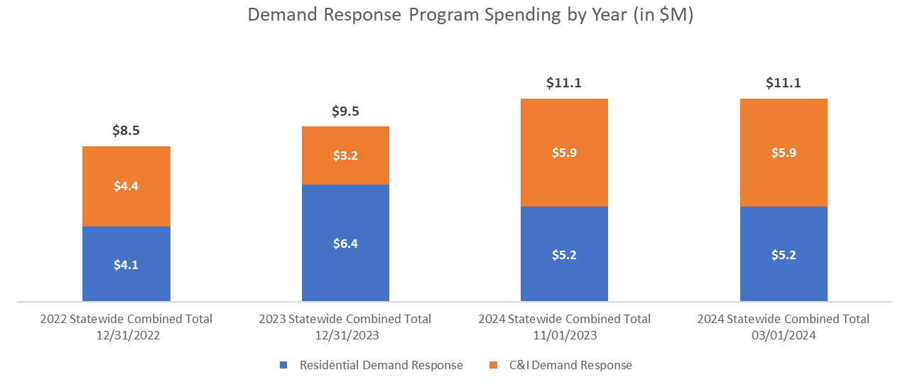
2022-2024 Demand Response Budgets

Slide 23
2024 Other Program Budgets

Slide 24
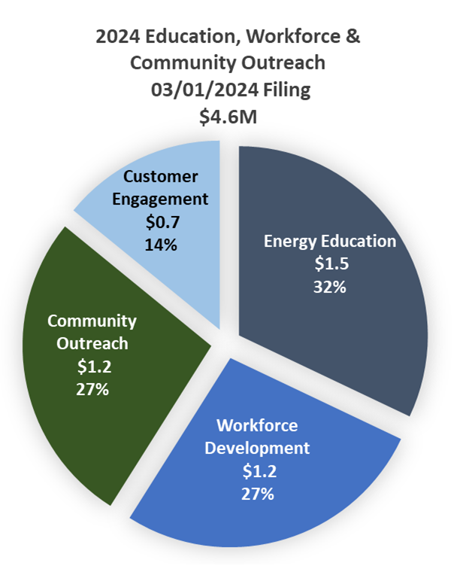
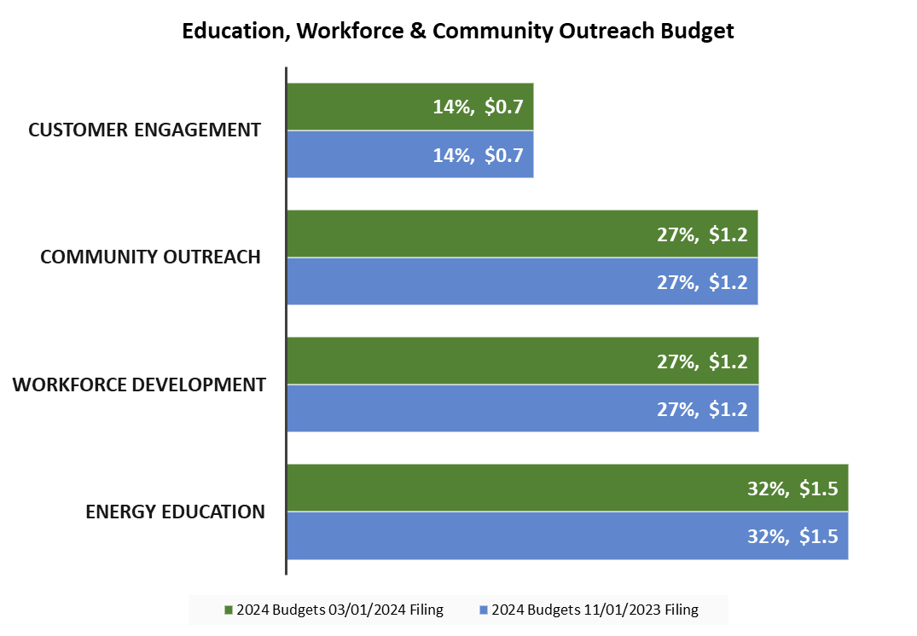
2024 Education, Workforce & Outreach Budgets
(compared to 11/1/2023 filing)

Slide 25
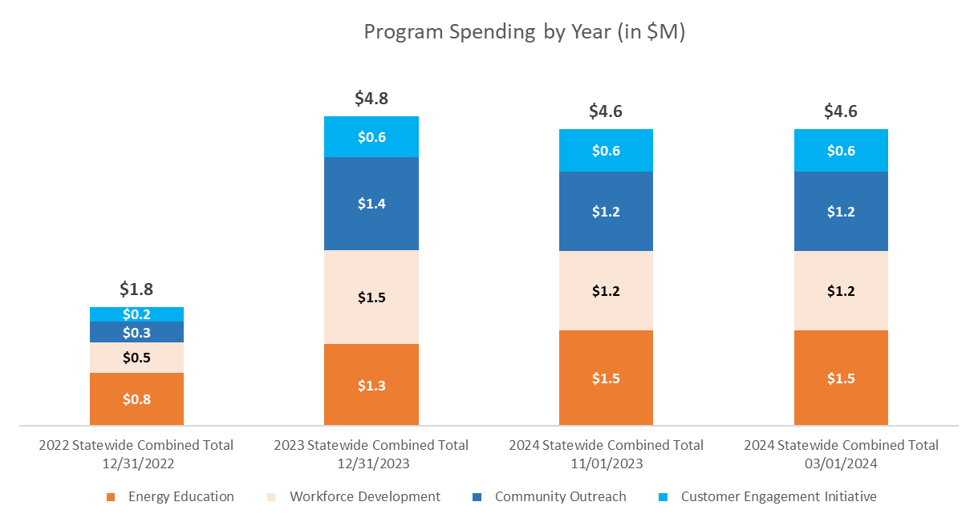
2022-2024 Education, Workforce and Community Outreach Budgets

Slide 26
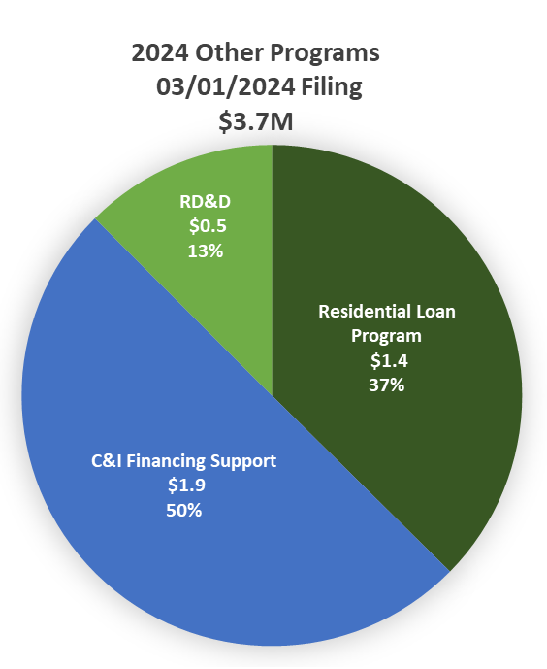
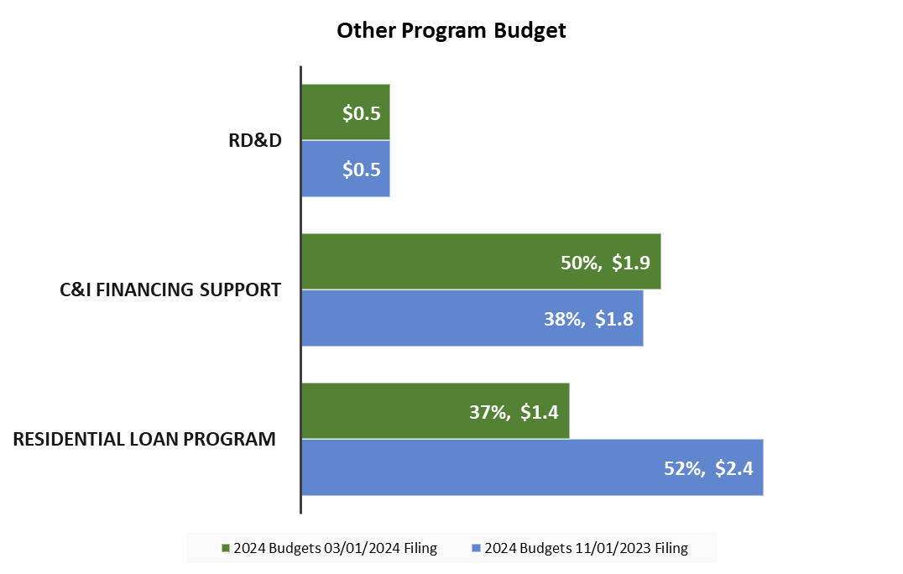
2024 Other / Financing Program Budgets
(compared to 11/1/2023 filing)

Slide 27
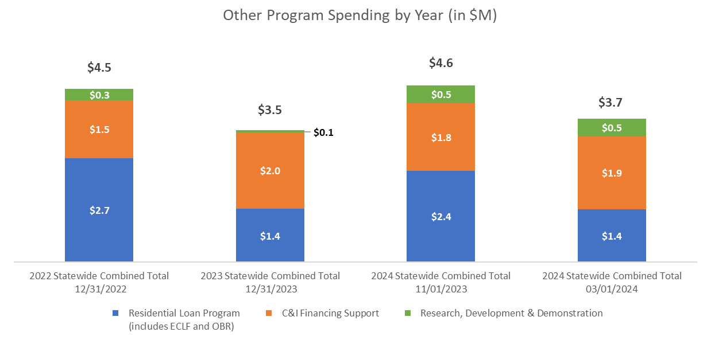
2022-2024 Other / Financing Program Budgets

Slide 28
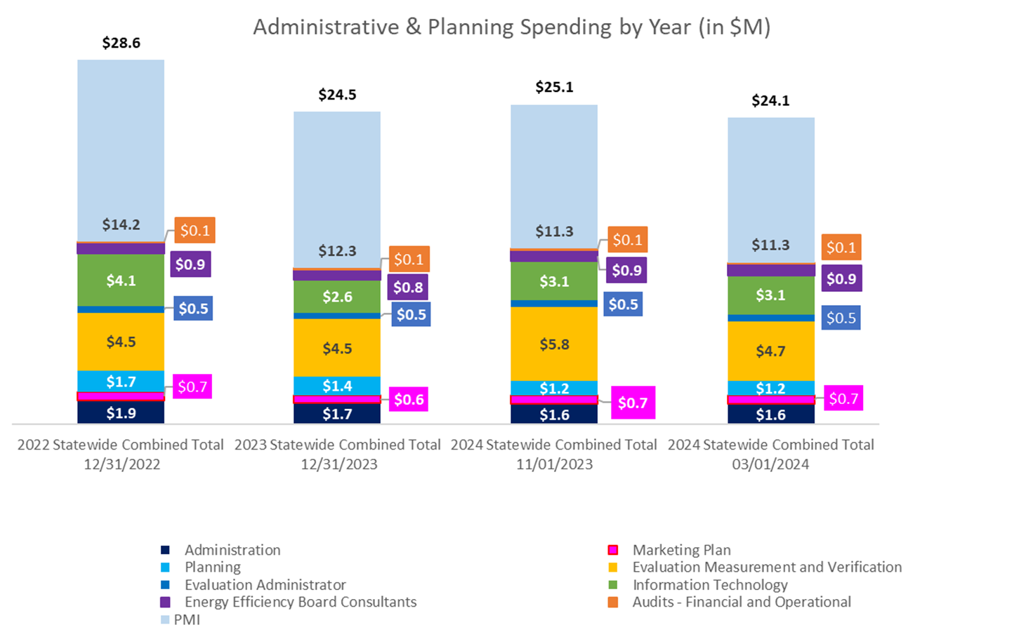
2022-2024 Administrative & Planning Budgets

Slide 29
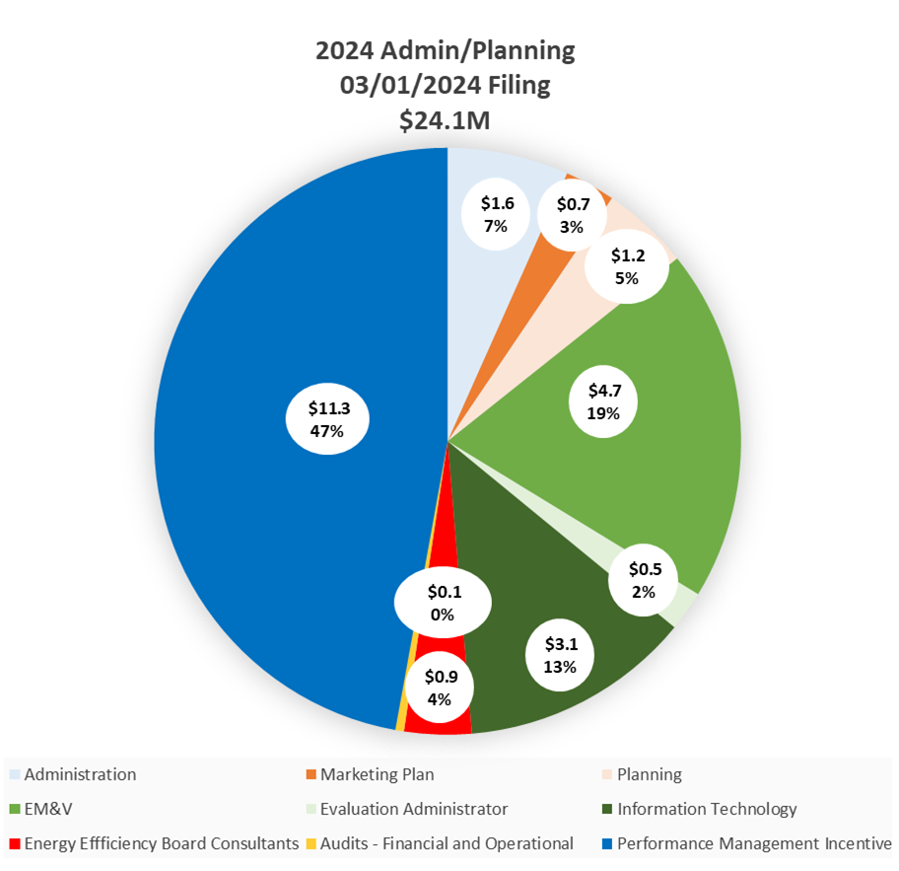
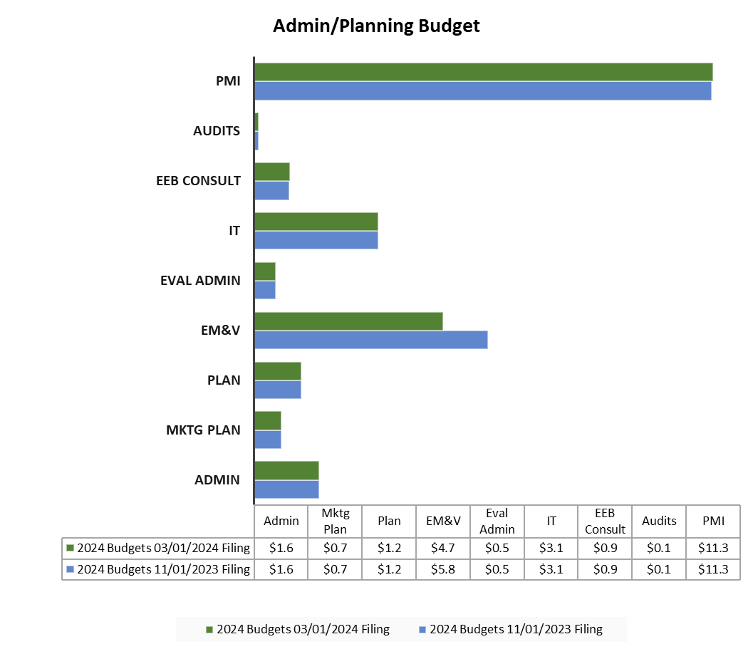
2024 Administrative / Planning Budgets
(compared to 11/1/2023 filing)

Slide 30
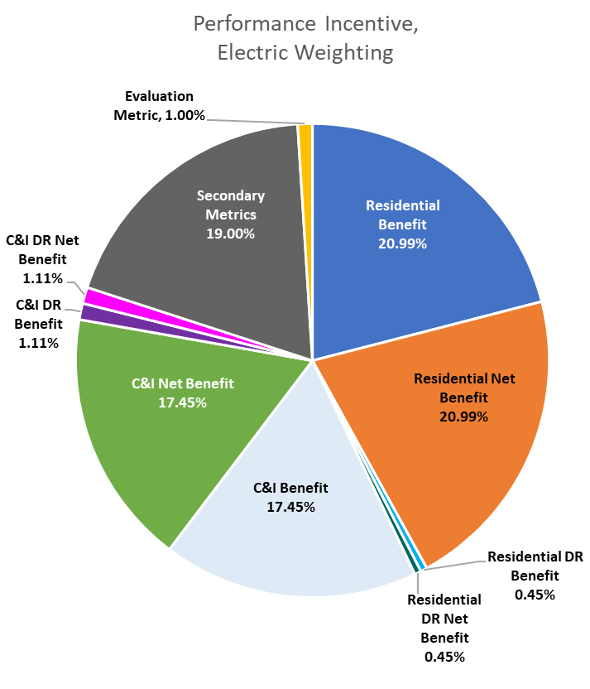
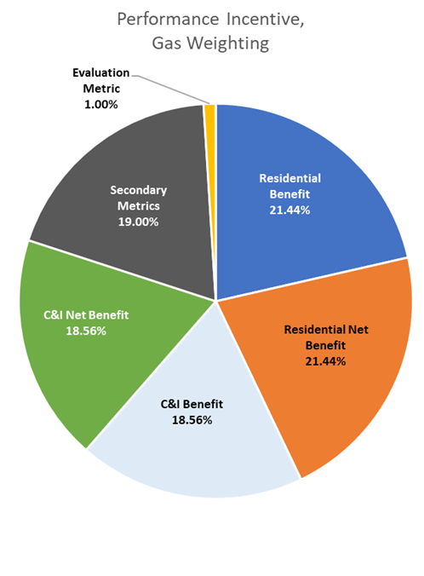
Performance Incentive Summary

Slide 31
Performance Incentive - Other Metrics

Slide 32
Performance Incentive - Other Metrics

Slide 33
Appendix

Slide 34
2024 Budget
Eversource (Electric)

Slide 35
2024 Budget
United Illuminating

Slide 36
2024 Budget
Eversource (Gas)

Slide 37
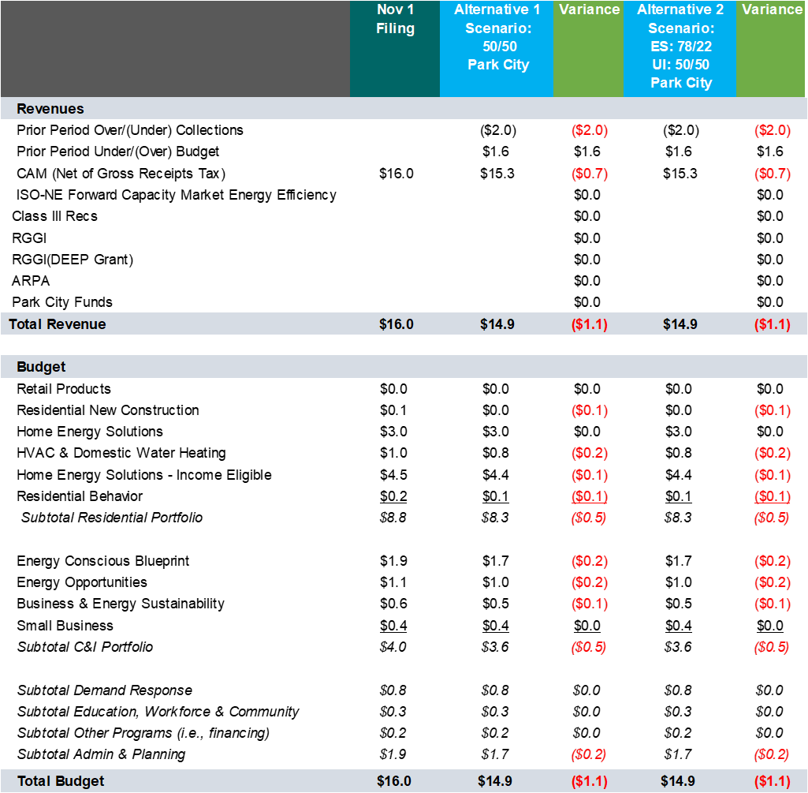
2024 Budget
CNG

Slide 38
2024 Budget
SCG

Slide 39
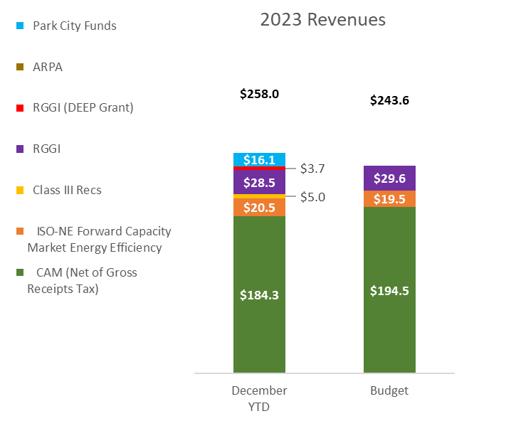
2023 Revenues vs. 11/1/2023
(all Companies)

Slide 40
2023 Actual vs.
Budget - All Companies

Slide 41
2023 Actual vs. Budget
(Eversource Electric)

Slide 42
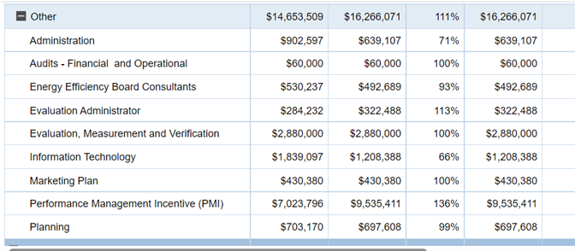
2023 Actual vs. Budget
Eversource Electric Administration
a
Budget Actual

Slide 43
2023 Actual vs. Budget - United Illuminating

Slide 44
2023 Actual vs. Budget - Eversource Gas

Slide 45
2023 Actual vs. Budget
- CNG

Slide 46
2023 Actual vs. Budget
- SCG

Slide 47
2024 Plan Update Savings and Benefits
Every $1 invested in EE results in $2.30 in lifetime benefits
Year | Budgets ($000) |  |  | Annual Savings |  |  |  |  |  |  | Lifetime Savings
 | Electric | Natural Gas | Total | Electric (GWh)* | Peak (MW) ** | Natural Gas (MMcf) | Oil (gallons) | Propane (gallons) | Annual Savings (MMBtus) *** | CO₂ Emissions (tons) | Lifetime Benefit ($000) | Lifetime Savings (MMBtus) ***
2022 | $199,845 | $44,878 | $244,723 | 197 | 135 | 382 | 1,548,671 | 294,364 | 1.3 | 126,510 | $598,196 | 16.8
2023 | $188,826 | $54,782 | $243,608 | 165 | 133 | 426 | 1,413,720 | 341,362 | 1.2 | 116,907 | $546,413 | 15.6
2024 | $189,002 | $57,391 | $246,393 | 153 | 139 | 450 | 1,575,625 | 394,920 | 1.2 | 116,741 | $546,712 | 15.8
Total | $577,673 | $157,051 | $734,724 | 515 | 407 | 1,258 | 4,538,016 | 1,030,647 | 3.8 | 360,158 | $1,691,321 | 48.2
*Abbreviation for Gigawatt hours
**Savings include active demand response programs
***In millions of MMBtu (one million British Thermal Units). Figures listed are site MMBtus and address only the energy saved at the meter level

Slide 48
2024 Revenues and Budgets
Electric: $189.0M (3% increase)
Natural Gas: $57.4M (4% increase)
Eversource: $146.4M (1.0% decrease)
United Illuminating: $42.6M (20.0% increase)
Eversource: $24.9M (2.0% increase)
CNG: $14.9M (7.0% decrease)
SCG: $17.5M (18.0% increase)

Slide 49
2022-2025 Electric Revenues
*RGGI Budget is based on calculation by the Companies and DEEP.
'**The EE FCM Payment Rates are: FCA-12-$4.63/kW-month, FCA-13-$3.80/kW-month, FCA-14-$2.00/kW-month, FCA-15-$2.61/kW-month, FCA-16-$2.59/kW-month and FCA-17-$2.59/kW-month

Slide 50
2022-2025 Natural Gas Revenues
All figures are net of GET. All Companies are decoupled.
2022 Other Revenues includes items such as RGGI.

Slide 51
Changes in Revenue (3/1/2024 vs. 11/1/2023

Slide 52
Preliminary 2024 Statewide Savings vs 11/01/2023 filing
Savings | 11/1/2023 | 3/1/2024 | % Change | Reason
Combined Annual MMBtu (electric, natural gas, oil, propane) | 1,116,372 | 1,129,998 | Increase 1.0% | Budget changes
Combined Lifetime MMBtu (electric, natural gas, oil, propane) | 14,224,008 | 14,376,228 | Increase 1.0% | Budget changes

